Slide 1
ANCIENT AND MODERN AFRICAN RESTAURANTS IN CANADA
Olulade John
26 February, 2021.

Slide 2
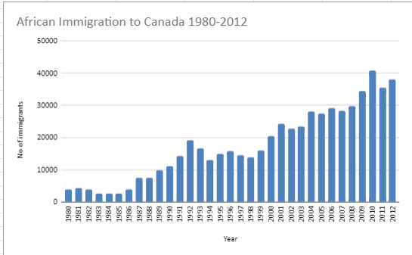
Business Problem
Lots of Africans are migrating to Canada and the figures are increasing by the year

Slide 3
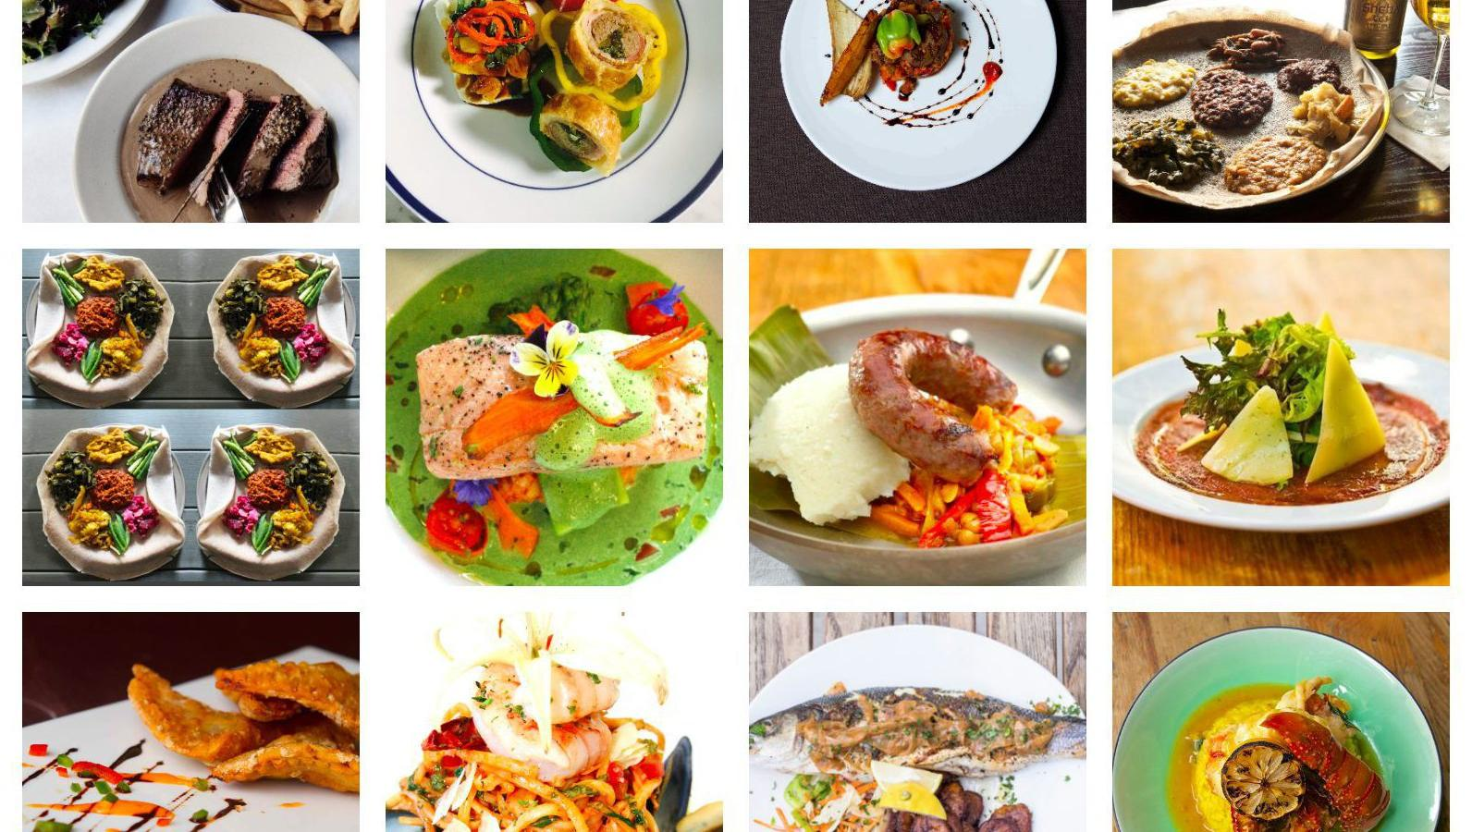
This growing population is underserved with African delicacies

Slide 4
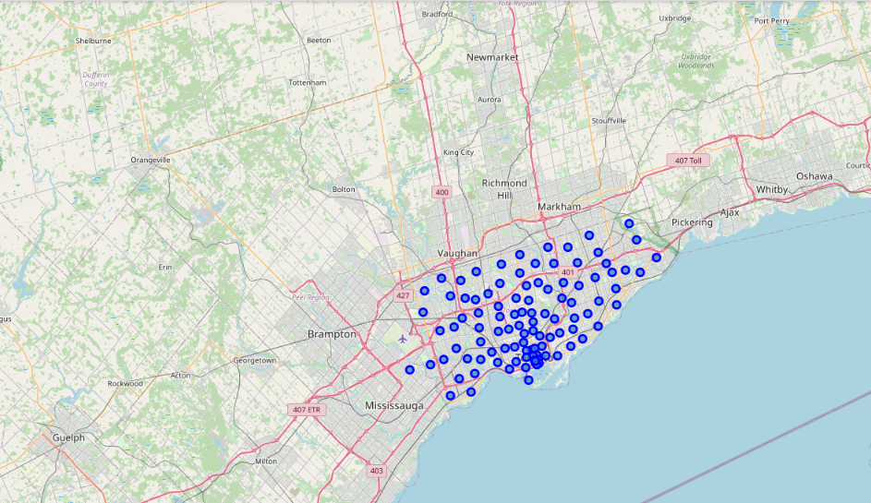
Toronto and its Surburbs

Slide 5
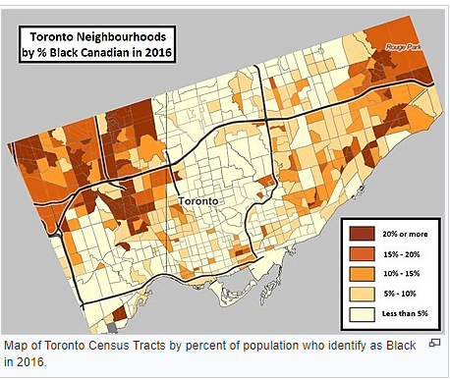
From research,
it was found that African dominated areas don’t have African Restaurants.

Slide 6
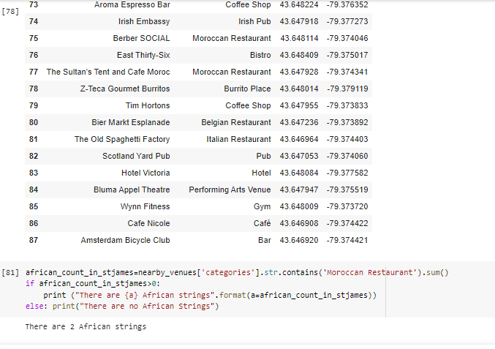
The closest are few Moroccan Restaurants which are inadequate to serve the growing population.

Slide 7
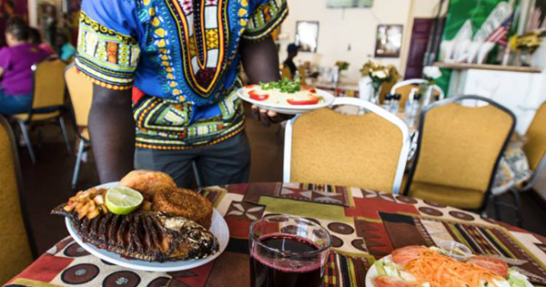
Conclusion
Setting up African restaurants with specialties in countries with related menu is a sure profit-making service delivery venture.

Slide 8
References
1. Wikipedia Page - Black Canadian Data
[https://en.wikipedia.org/wiki/Black_Canadians]
2. African Immigration to Canada - 1980 to 2013 data
[https://drive.google.com/file/d/1qHgLEZQR7DKtau_9KkDqsvdLvoTdWUsh/view?usp=sharing]
3. Canada M Postal Codes, borough, neighborhood [https://en.wikipedia.org/wiki/List_of_postal_codes_of_Canada:_M]
4. Canada M Postal Codes, latitude , longitude
[http://cocl.us/Geospatial_data]
5. Number of restaurants, type, location and neighborhood - Foursquare API [https://foursquare.com]

